Slide 1

!S6 Bluejacking
Sydney Hardwick
IIT School of Applied Technology
shardwic@hawk.iit.edu
Pi Lai Ngai
IIT School of Applied Technology
pngai@hawk.iit.edu
Chaz Granholm
IIT School of Applied Technology
cgranhol@hawk.iit.edu

Slide 2
Problem
There are not a lot of cost efficient ways to monitor and explore Bluetooth and Bluejacking traffic.
Most tools are very expensive
Notes:
Briefly define the problem. (1 slide)
1. How will this project make a difference in the future

Slide 3
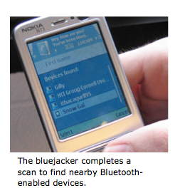
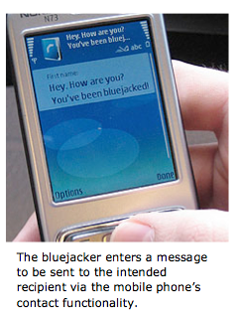
Bluetooth +Bluejacking
Notes:
Briefly describe how your system works. (2-4 slides)
System1 = bluejacking (slide 2)
Sending unsolicited messages via the vcard in the bluetooth protocol stack

Slide 4
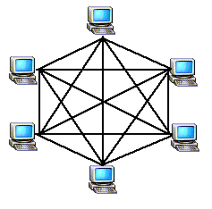
Mesh Networking
Notes:
Describe how mesh networking topology works

Slide 5
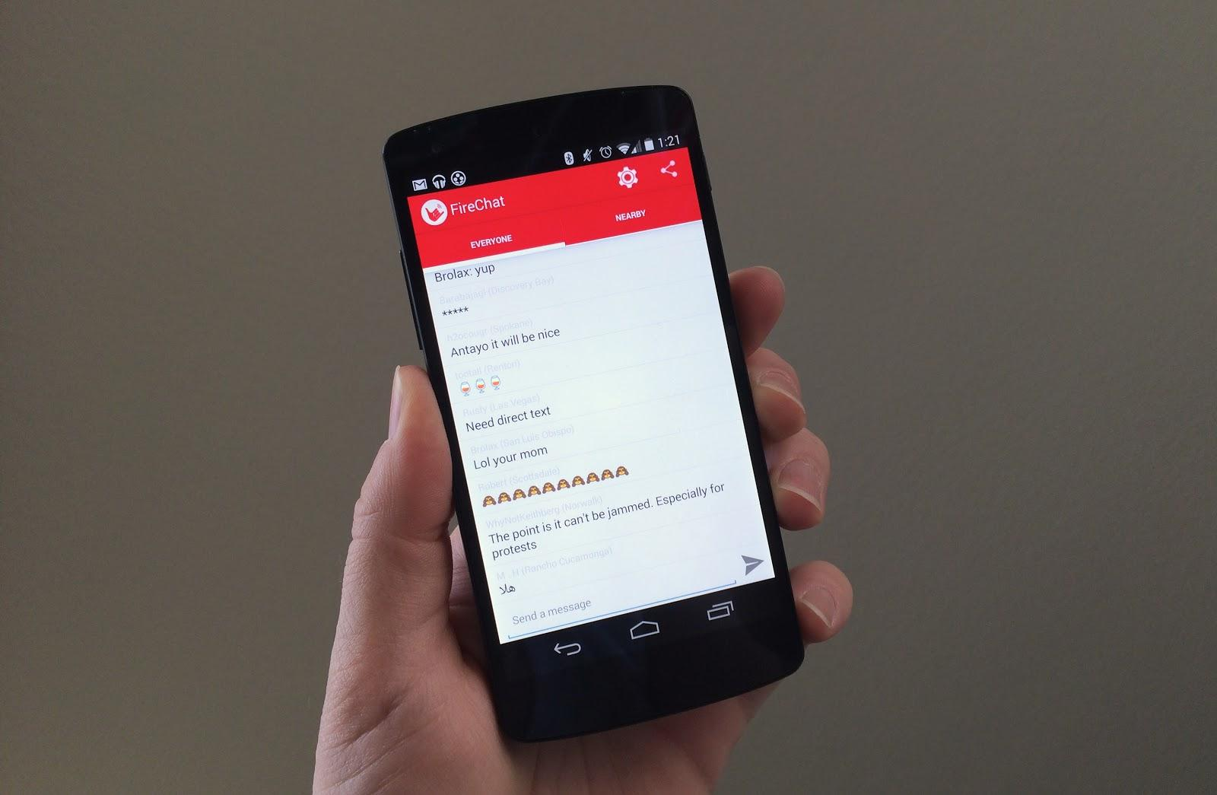
Firechat
Sends messages via Bluetooth using ad-hock wifi without Cellular Service
Hong Kong Importance
Notes:
Briefly discuss how your system solves the problem. (1-2 slides)

Slide 6
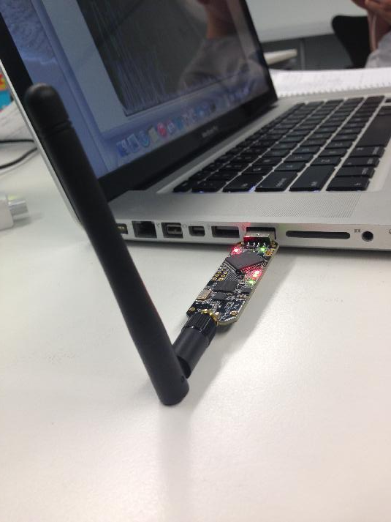
Solution: Ubertooth One
Ubertooth One monitors Bluetooth activity and provides a better understanding of how to prevent bluejacking
Notes:
Briefly discuss how your system solves the problem. (1-2 slides)

Slide 7
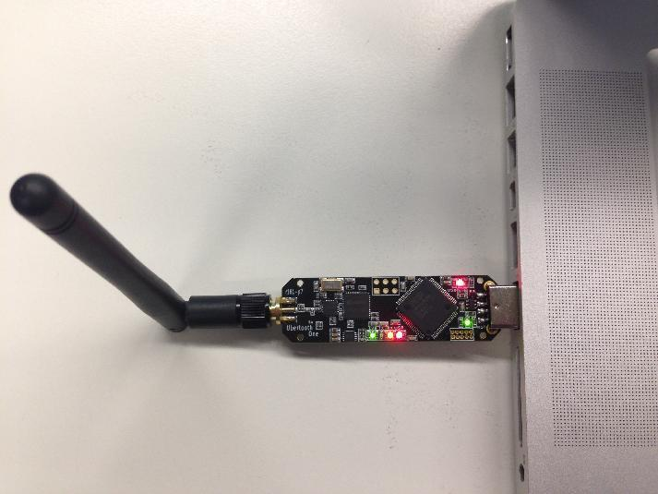
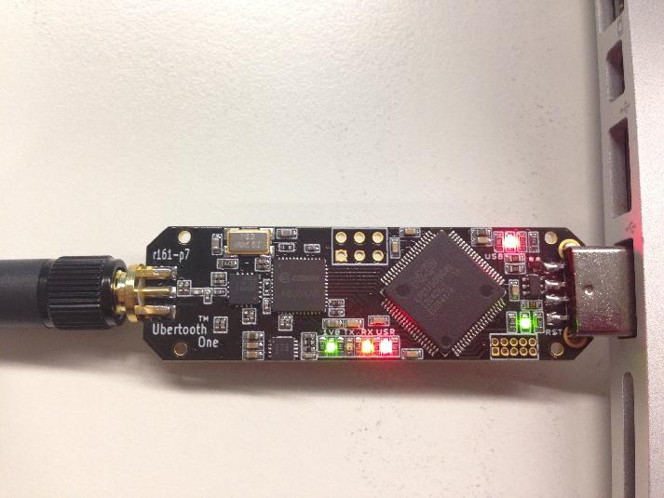
Ubertooth One
Notes:
Briefly describe how your system works. (2-4 slides)
System1 = Ubertooth One(slide 3 )

Slide 8
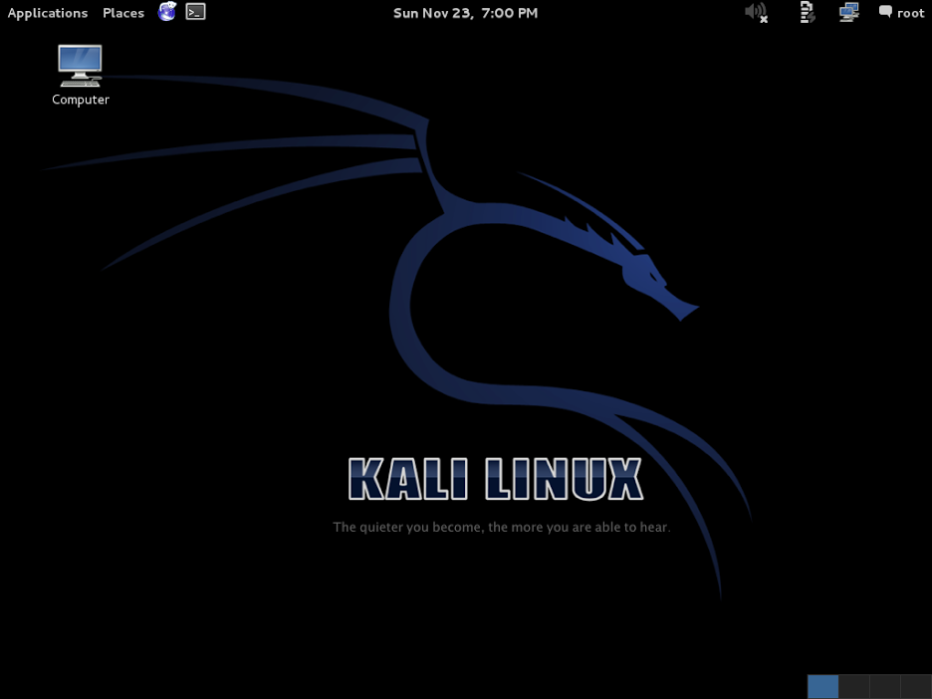
Kali Linux
Notes:
Tell and show with screen shots what we will see in your demonstration that will follow your presentation.
(3-4 slides)
Slide 1 = Setup of Ubertooth code in terminal
- file structure
- to run the commands – you have to be in the right file
- Talk about Kali linux and its functionality with this system – how it was once backtrack, etc.

Slide 9
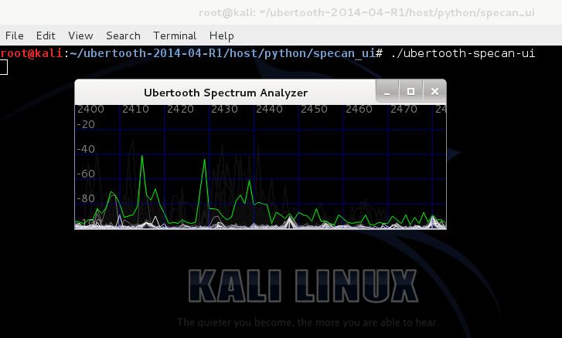
Spectrum Analyzer
Notes:
Tell and show with screen shots what we will see in your demonstration that will follow your presentation.
(3-4 slides)
Slide 2 = Spectrum Analyzer
Cool video - http://www.sharebrained.com/2011/05/24/ubertooth-spectrum-analysis-fun/
https://www.youtube.com/watch?v=DCYrrNQc3lM

Slide 10
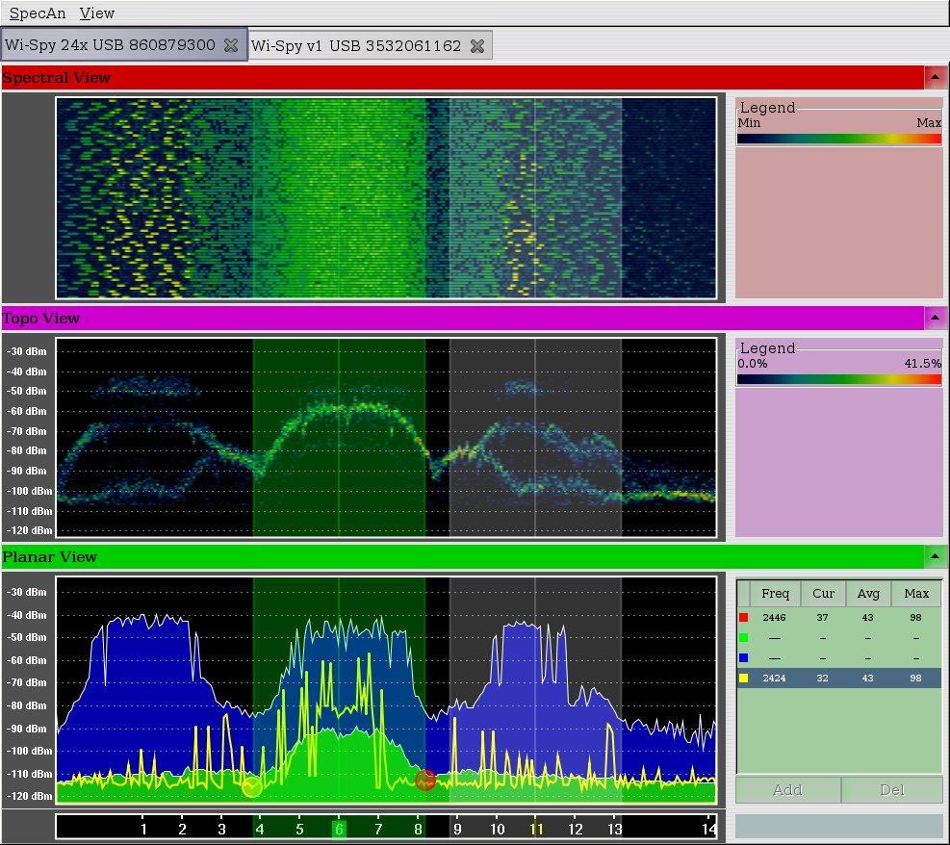
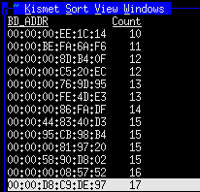
Kismet
Notes:
Tell and show with screen shots what we will see in your demonstration that will follow your presentation.
(3-4 slides)
Slide 1 = Kismet
Plugin for ubertooth
See link - http://penturalabs.wordpress.com/2013/09/01/ubertooth-open-source-bluetooth-sniffing/

Slide 11
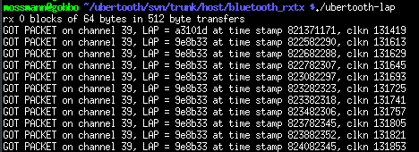
Bluesniffing/LAP Sniffing
Notes:
Allows to identify bluetooth activity operating in vicinity

Slide 12
Project Projections...
Notes:
identify project projections

